Slide 1
“Tracer Racers” – an Implementation of the “Racetrack” Game
Muhammad Mogra
Notes:
Introduction…

Slide 2
Topics
Background & Motivation
Objectives
Application Infrastructure
Track Representation
Gameplay Procedure
Progress Reflection
Questions & Demo
Notes:
Go through the topics briefly

Slide 3
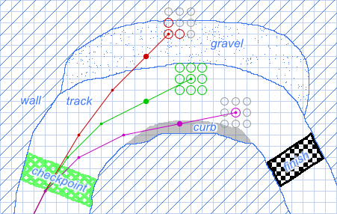
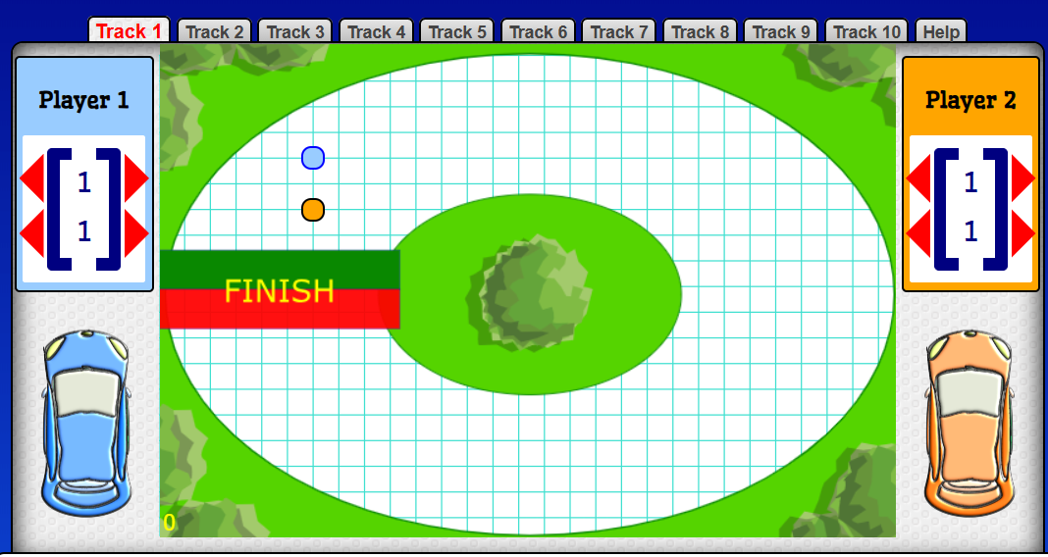
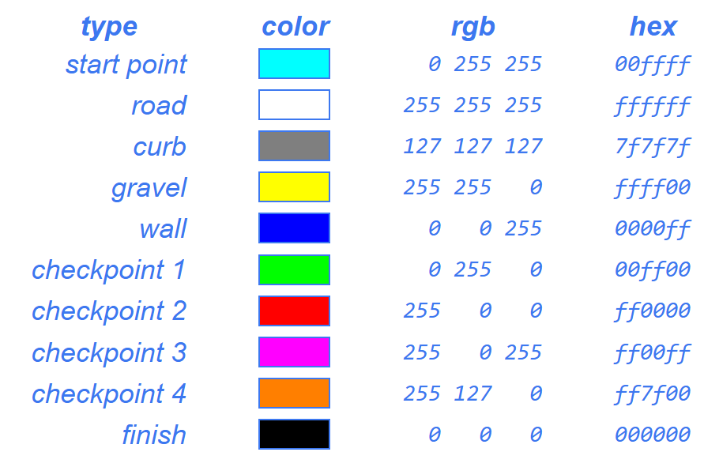
Background
Background & Motivation (Topic 1 / 7)
The “Racetrack” game is a pencil-and-paper 2D racing game¹
Players use vectors to incrementally race around the track
Figure 1 – Vector Racer, tutorial page
Figure 2 – Inertia Racetrack, holistic view
Figure 3 – Vector Racer,
Track components
Notes:
Describe what the Racetrack game is
Talk through the image of the Racetrack game (explain the gameplay mechanics)
Show examples of existing Racetrack-like games
Inertia Racetrack – simple 2-player version of the Racetrack game
Vector Racer – more sophisticated version with local multiplayer, varied AI racers, and custom track buildin

Slide 4
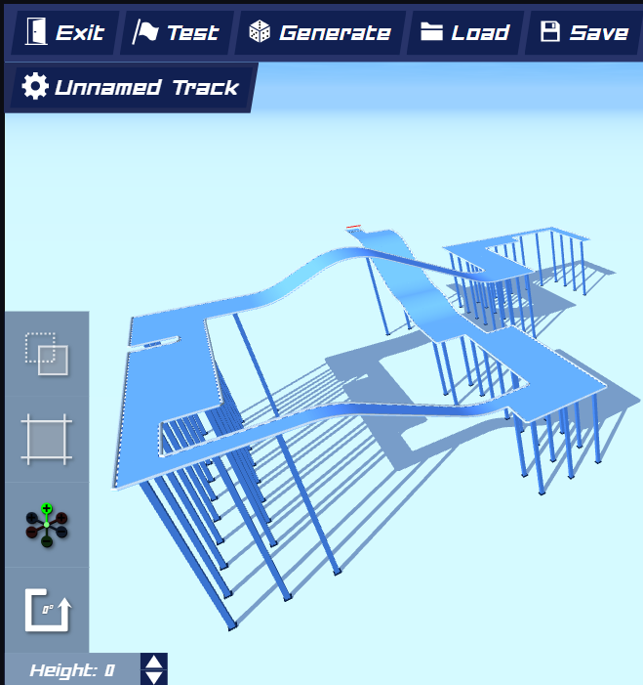
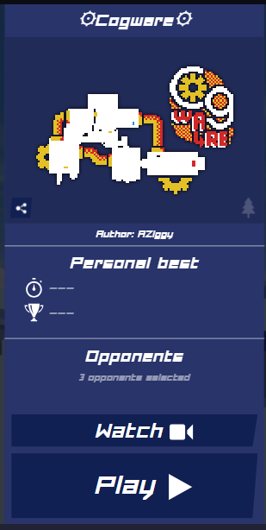

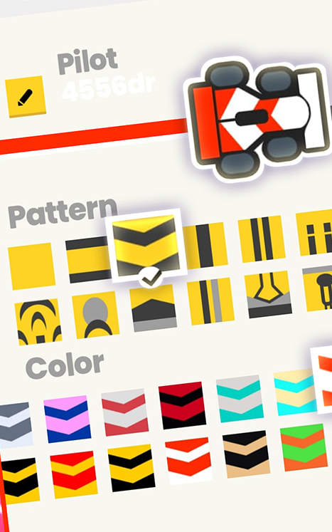
Motivation
Background & Motivation (Topic 1 / 7)
Existing Racetrack-like games are “basic”^{2,3}
Aims to expand and combine features of these existing games^{4,5,6}
Figure 5 – PolyTrack,
track info
Figure 6 – GPixel,
track conditions
Figure 4 – PolyTrack, building area
Figure 7 – GPixel, customisation
Notes:
Talk about Inertia Racetrack and Vector Racer
Explain what’s basic about them, including:
Limited player count (both)
No explicit multiplayer (Vector Racer has leaderboards)
Not many material types (Vector Racer)
No built-in track builder to see live look (Vector Racer takes externally drawn image)
Minimal customisation (neither)

Slide 5
Objectives
Objectives (Topic 2 / 7)
(Key) Primary Objectives
Enable players to race around tracks with vectors
Enable players to create tracks
Enable players to manage their tracks
Enable players to race against other players locally
Enable players to race against AI racers
Secondary Objectives
Enable players to race against other players online
Enable players to race against AI racers of varying difficulty
Enable players to personalise their gameplay experience
Notes:
Considering what existing Racetrack-like games lack, these are the objectives
Talk through each objective
Start off with plain list (black)
… then show what’s been done (green)
… and what’s to be done (orange)

Slide 6
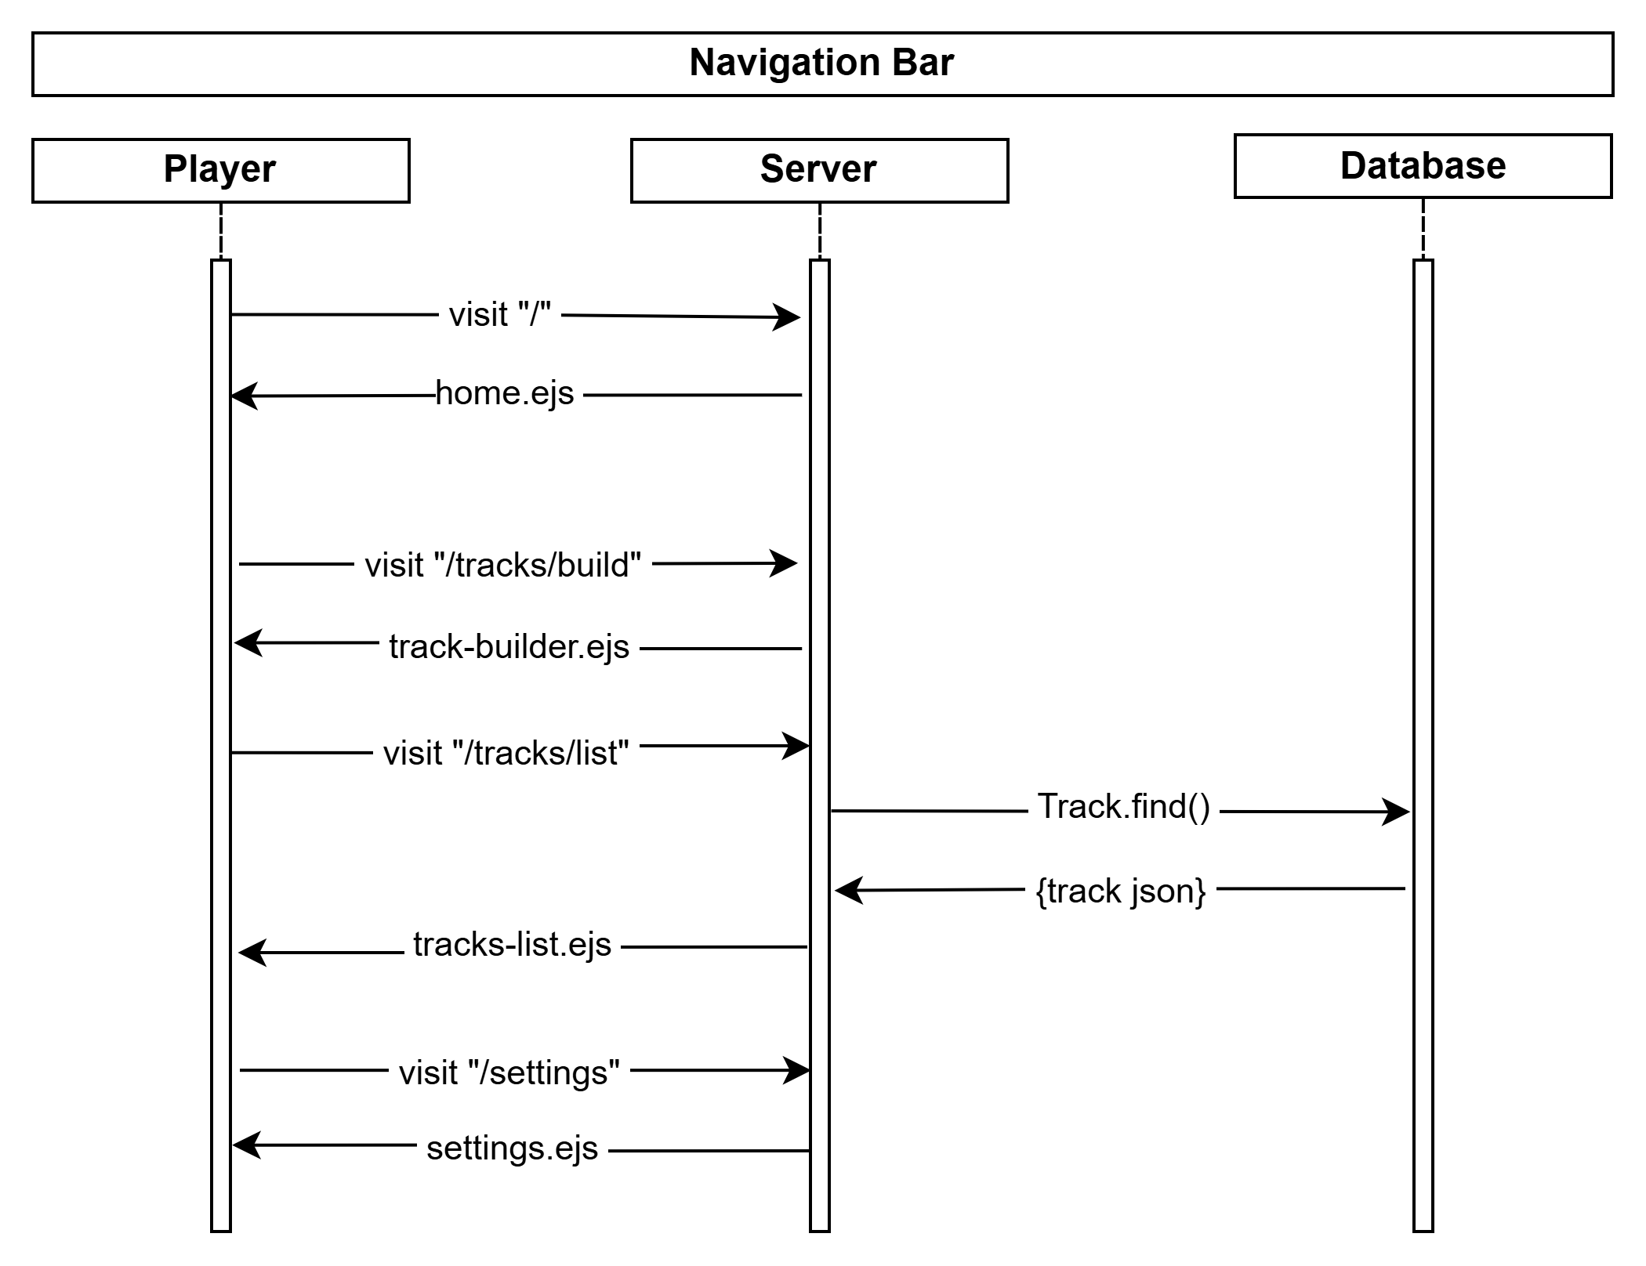
Application Infrastructure
Application Infrastructure (Topic 3 / 7)
Front-end: HTML (as .ejs), JavaScript, CSS (Bootstrap)
Back-end: Node.js, MongoDB
Player creates requests
Server handles them
Server requests DB for data
Figure 8 – Project v1.7.0, sequence diagram of Navigation Bar
Notes:
Talk about front-end / back-end technologies
Talk about typical structure of request (client -> server -> database)
Talk through navigation bar operations (just returning screens)

Slide 7
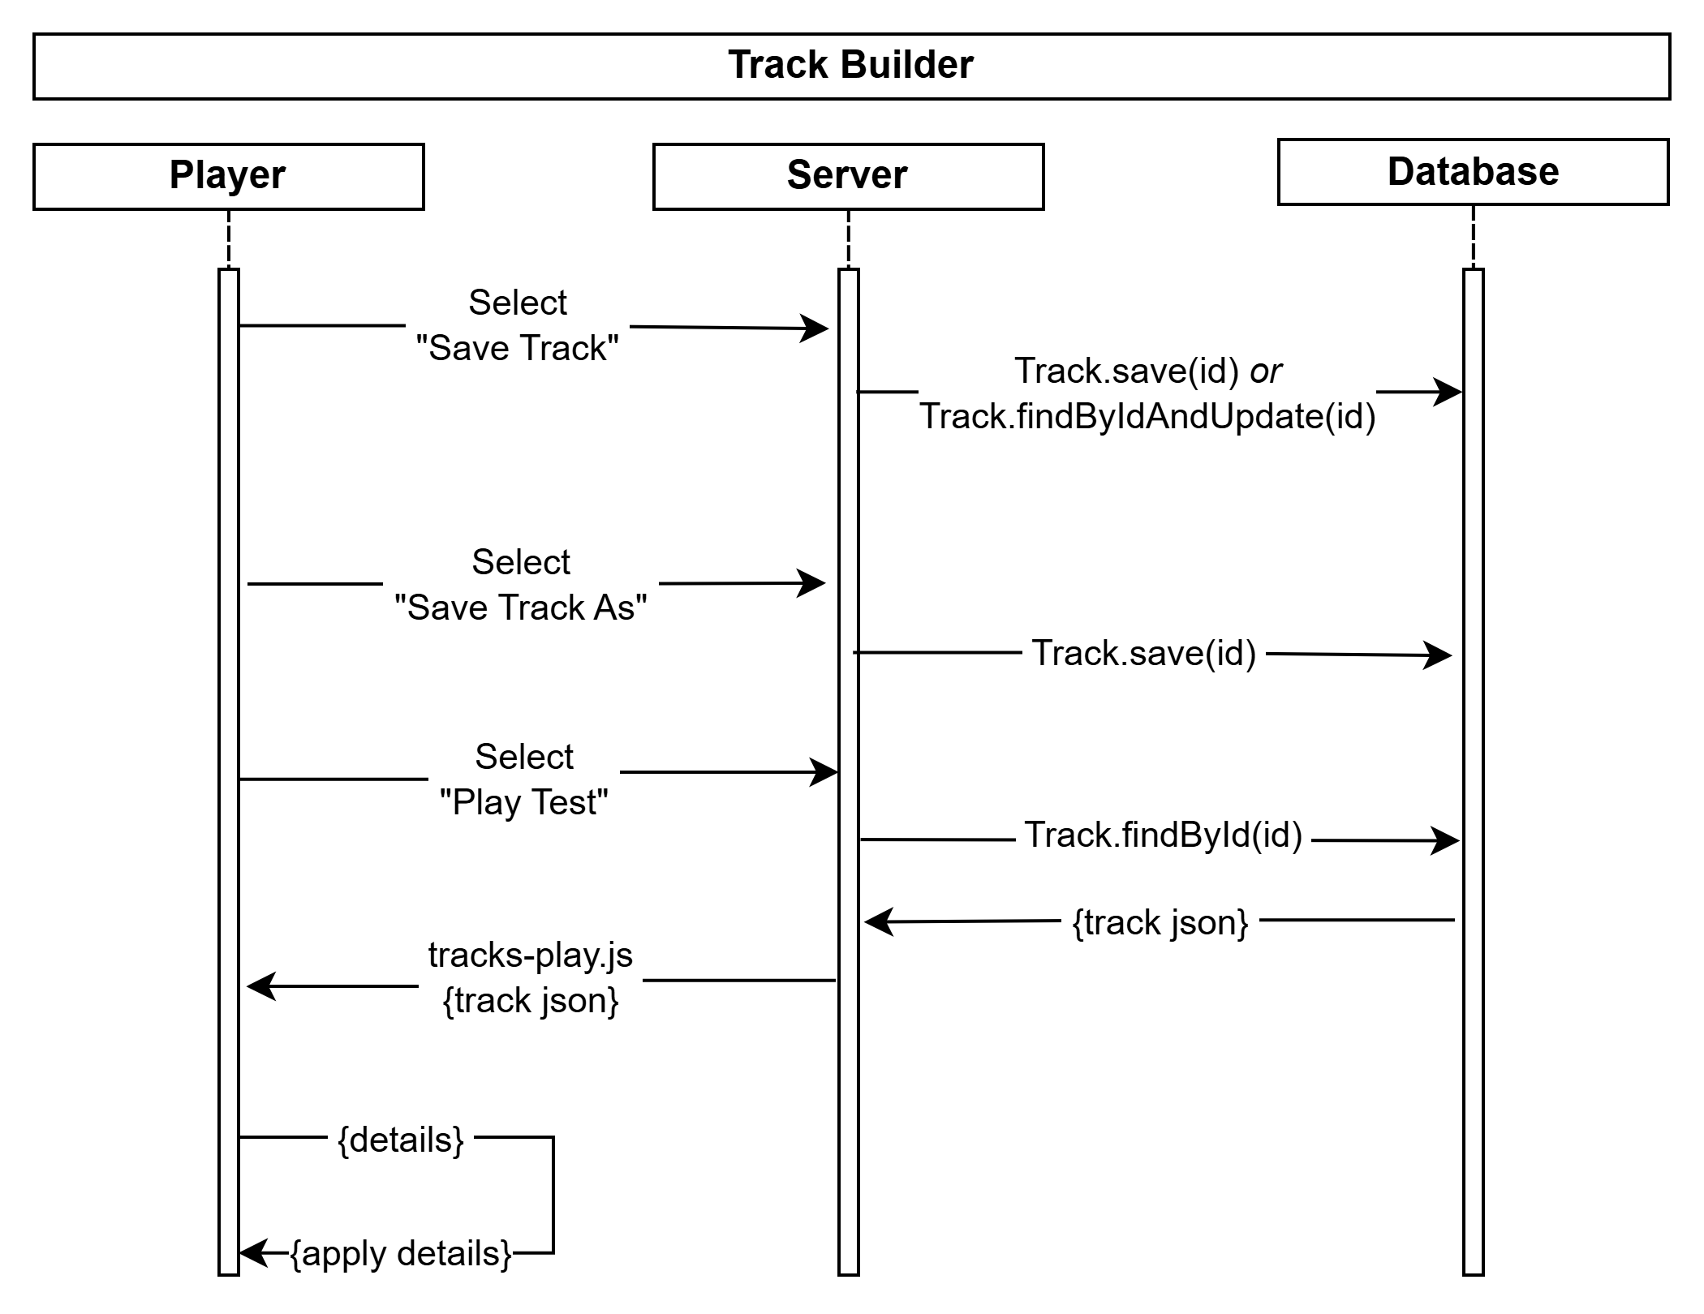
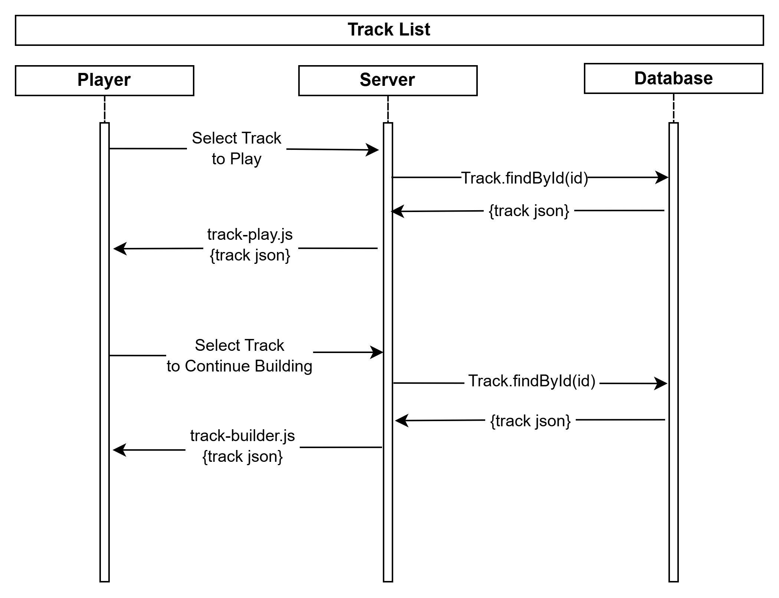
Application Infrastructure
Application Infrastructure (Topic 3 / 7)
Figure 9 – Project v1.7.0, sequence diagram of Track Builder
Figure 10 – Project v1.7.0, sequence diagram of Tracks List
Notes:
Talk through each sequence diagram (track builder, track list)
Track gameplay isn’t that interesting – mainly just client operations
… BUT logic will likely be verified on the server in the future

Slide 8
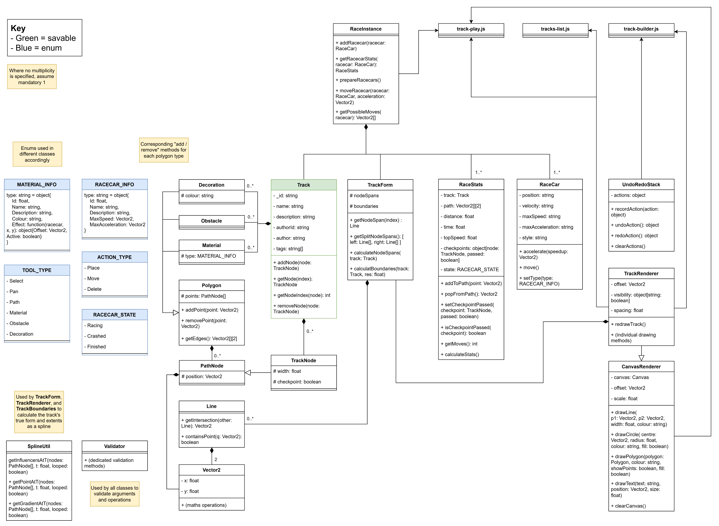
Class Diagrams
Application Infrastructure (Topic 3 / 7)
Figure 11 – Project v1.7.0, class diagram
Class Groups
Geometry
Track Parts
Rendering
Gameplay
Enums
Utilities
Notes:
Zoom into class diagram
Classes can be largely grouped into “these” categories
Show the different components
3 main scripts which use these objects (builder, lister, player)
(brief diagram to not be so large – covers the key parts)

Slide 9
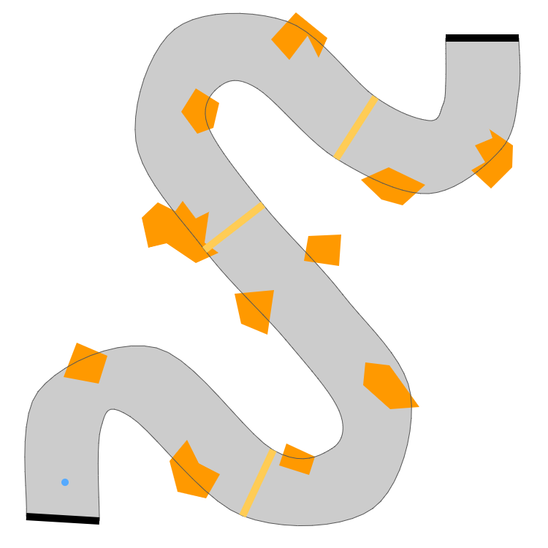
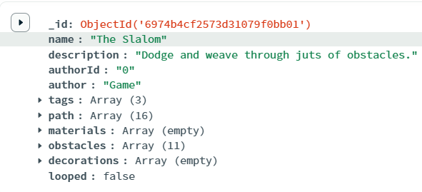
Track Representation
Track Representation (Topic 4 / 7)
Two main approaches: capture track as nodes⁷, or as matrix / image³
Decided to use nodes – more memory efficient, and easier to map!
Figure 12 – Project v1.7.0, track w/o widgets
Figure 13 – MongoDB, track JSON
Example:
The Slalom
78.6 KB PNG image…
… vs. 2.8 KB JSON!
Less “creative freedom”, but can be improved / enabled through UX
Notes:
Talk through approaches (nodes vs. images)
More memory efficient
Easier to map (in terms of collisions and intersections, can use concrete boundaries)
Show the example of a track that shows the difference
Maybe – share “how” you got 78.6 KB (removed widgets, then saved canvas as image)

Slide 10
Spline Calculations
Track Representation (Topic 4 / 7)
Based on the Catmull-Rom spline^{8,11,12,13}
Passes through all points and uses local control^{11,12,13}
… which makes it great for track building!
1. Let n = # of track nodes
2. If the track is looped, use n – 1 instead
3. Let r be the resolution of t
4. For t = 0 to n (step r)…
5.1. Gather all relevant nodes around t
5.2. Derive node influences by position
5.3. Calculate point at t from influences
5.4. Draw point to track
  Desmos Demo⁸: https://www.desmos.com/calculator/yerscywwaf
Notes:
Start off with track WITHOUT widgets
… then transition to track WITH widgets
… and show each of the arrows / components one by one
Maybe – show the Desmos demo to demonstrate the spline’s maths

Slide 11
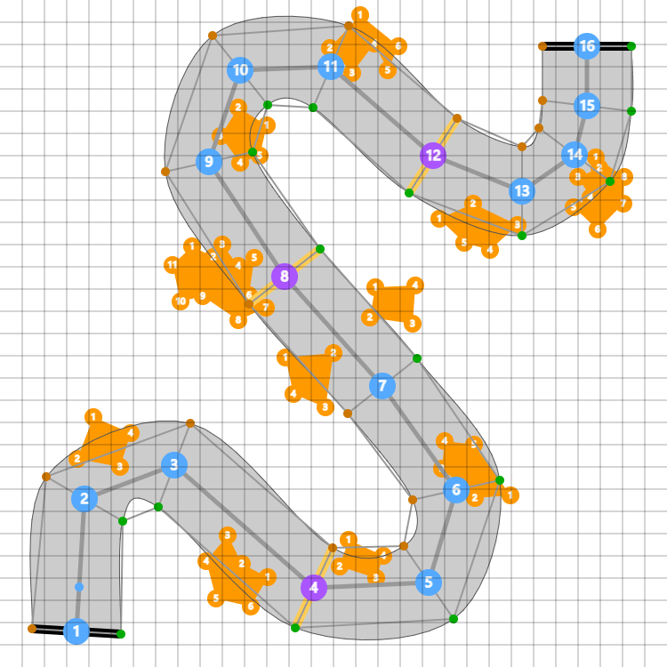
Track Representation
Track Representation (Topic 4 / 7)
Figure 12 & 14 – Project v1.7.0, track w/o & w/ widgets
Series of nodes as a spline^{7,8} (blue)
Materials, obstacles, decorations (“polygons”)
Node widths⁸ (orange-green)
Track path (light grey)
Checkpoint marking (yellow)
Wireframe (dark grey)
Notes:
Start off with track WITHOUT widgets
… then transition to track WITH widgets
… and show each of the arrows / components one by one
Maybe – show the Desmos demo to demonstrate the spline’s maths

Slide 12
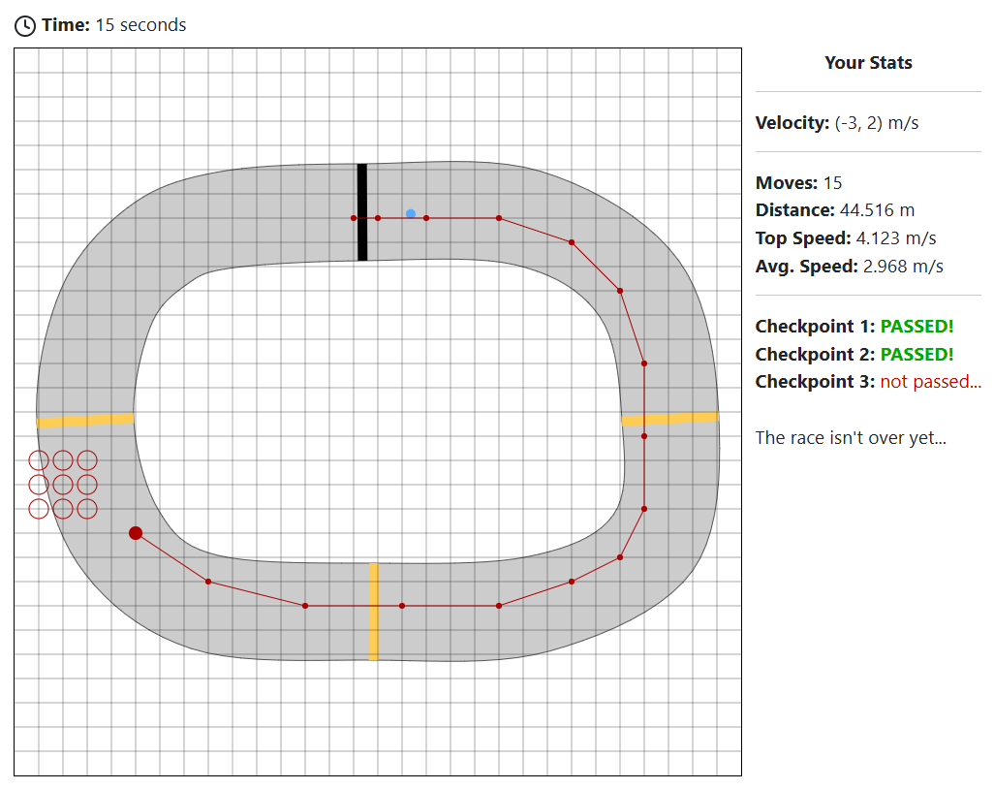
Gameplay Procedure
Gameplay Procedure (Topic 5 / 7)
Track and race car chosen by player
Turn-based prompting
Figure 15 – Project v1.7.0, and example of an active race
1. Start the game
2. Gather all available moves
  3. The race car chooses a valid move
  4. Determine move outcome
  5. If OK and not finished, repeat Step 2
  6. If crashed or finished, end the game
Notes:
Summarise basic gameplay procedure
Step 2 and Step 4 are where most of the operations are
… which is what will be examined more closely

Slide 13
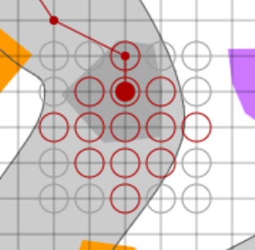
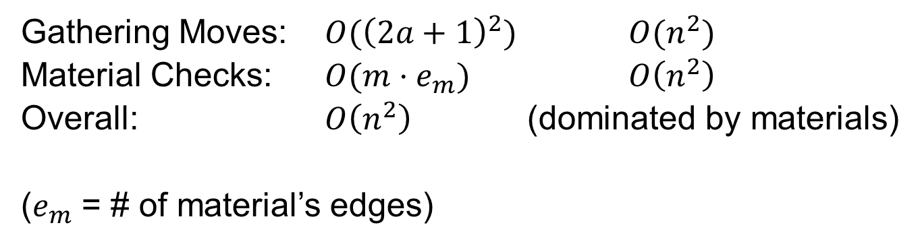
Move Availability
Gameplay Procedure (Topic 5 / 7)
1. Start the game
2.1. For the race car…
2.2. Gather its available moves by its velocity and acceleration
2.3. Limit its moves based on the material its in (if any)
2.4. Limit its moves based on its max velocity
  3. The race car makes a valid move and its velocity is accelerated
  …
Figure 16 – Project v1.7.0, a race car on gravel with
its available (red) and unavailable (grey) moves
  Gathering Moves: $O({\left(2a+1\right)}^{2})$ $O(n^{2})$
  Material Checks: $O(m⋅e_{m})$ $O\left(n^{2}\right)$
  Overall: $O\left(n^{2}\right)$ (dominated by materials)
  ($e_{m}$ = # of material’s edges)
Notes:
Talk through the move determiner algorithm

Slide 14
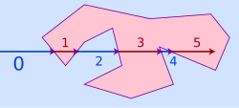

Material Containment
Gameplay Procedure (Topic 5 / 7)
Uses the Ray Casting Algorithm to determine containment⁹
… and another procedure to determine intersections¹⁰
2.3.1. Define a long arbitrary ray from the race car’s position
2.3.2. For each material…
2.3.3. For each edge of the material’s polygon…
2.3.4. Check if the ray intersects with the edge
2.3.5. If so, count it as an intersection
2.3.6. If there are odd intersections – stop & use this
2.3.7. Otherwise, check other materials
Figure 17 – Wikipedia,
Ray Casting algorithm
  Gathering edges: $O\left(m⋅e_{m}\right)$ $O(n^{2})$
  Intersection check: $O\left(1\right)$ $O(1)$
  Overall: $O\left(n^{2}\right)$
Notes:
Talk through material containment algorithm

Slide 15
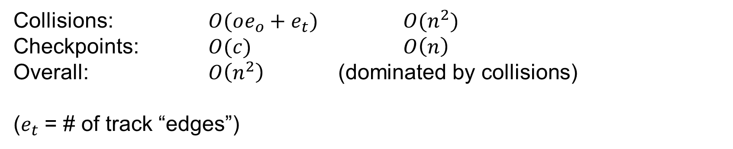
Path Collisions
Gameplay Procedure (Topic 5 / 7)
  …
  3. The race car makes a valid move and its velocity is accelerated
  4.1. If the race car crossed…
  4.2. A checkpoint in order: mark the checkpoint as passed
  4.3. The finish line after passing all checkpoints: they win!
  4.4. A track boundary or obstacle: crash the race car!
  5. If not crashed or finished, prompt for another move (Step 2)
  6. If crashed or finished, display the player’s results
Similar procedure for obstacle collisions, except the ray is the race car’s travel path
  Collisions: $O(oe_{o}+e_{t})$ $O(n^{2})$
  Checkpoints: $O(c)$ $O\left(n\right)$
  Overall: $O\left(n^{2}\right)$ (dominated by collisions)
  ($e_{t}$ = # of track “edges”)
Notes:
Talk through collision detection algorithm for…
… checkpoints (and ordering)
… the finish line (linked to checkpoint passing)
… and track boundaries / obstacles (crashing)
Talk through end-game procedure (win / crash)

Slide 16
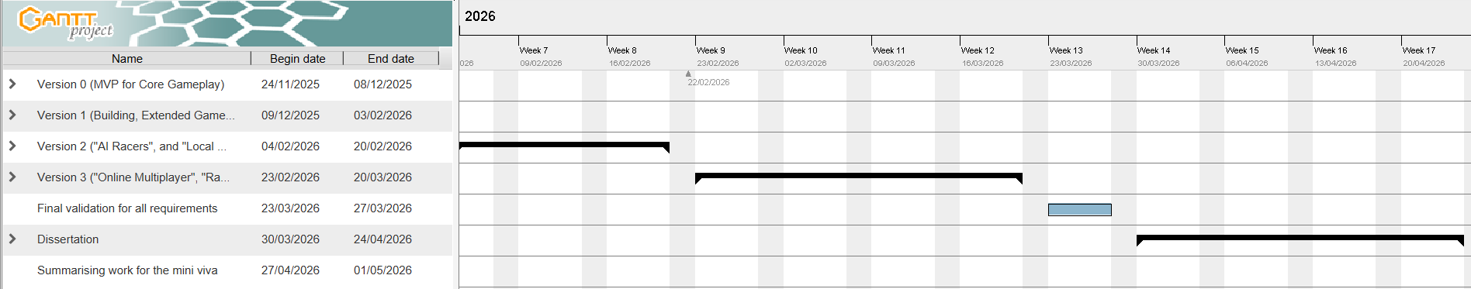
What’s Gone Well?
Gameplay Procedure (Topic 6 / 7)
According to project schedule – on track!
Successfully implemented JS equivalent from prototype
OOP has helped with reusability (e.g., rendering for building & gameplay)
Integrated MongoDB directly ahead of text-based storage
Learned and applied unit testing to cover most edge cases
Figure 17 – Project, timeline of current progress (as of 11/02/26)
Notes:
Talk through progress as of the project start
Talk through successes

Slide 17
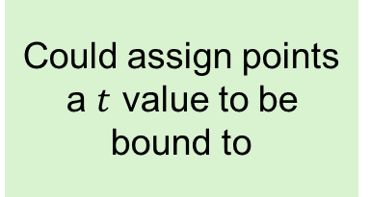
What Could Improve?
Gameplay Procedure (Topic 6 / 7)
Subtle edge cases not yet covered
UX issues – colours, redundant interactions
Other limitations include…
Polygons can’t be “locked” to track form (frustrating if track moves)
Collision logic doesn’t allow “folded” tracks
Spline shape determined by fixed formulae
Algorithm efficiency (mainly drawing & collisions!
  Could assign points a $t$ value to be bound to
  Could add an “altitude” to boundaries
  Could let users give custom equations
  Could add canvas per track “layer” / check bounds by segment
Notes:
Talk through current shortcomings and proposed improvements

Slide 18
Thank you!
(Topic 7 / 7)
Any questions?
Free for demo!
Notes:
GET ON THAT DEMO!!!

Slide 19
References
PowerPoint template created by the University of Leicester.
[1] The Racetrack Game concept
[2] Inertia Racetrack
[3] Vector Racer
[4] PolyTrack
[5] GPixel
[6] Formulky
[7] Programming splines video
[8] Creating racetracks with splines video

Slide 20
References
[9] Ray Casting Algorithm
[10] Intersection Calculator
[11] Graphics in 5 Minutes, “Splines in 5 Minutes: Part 2 – Catmull-Rom and Natural Cubic Splines”
[12] Graphics in 5 Minutes, “Splines in 5 Minutes: Part 3 – B-splines and 2D”
[13] “A Class of Local Interpolating Splines” (Edwin Catmull, Raphael Rom – original paper)

